Slide 1
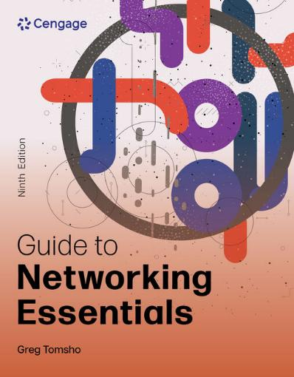
Guide to Networking Essentials, 9e
Chapter 2: Network Hardware Essentials
.

Slide 2
Chapter Objectives
By the end of this chapter, you should be able to:
Describe the basic operation of network repeaters and hubs
Explain the operation of network switches
Explain how wireless access points work
Describe the operation of network interface cards
Explain the function of routers

Slide 3
Network Repeaters and Hubs (1 of 2)
Early networks didn’t use interconnecting devices
This limited the total cable length and number of computers that could be connected
Some problems were resolved with a device called a repeater
A repeater receives bit signals generated by NICs and other devices, strengthens them, and then “repeats” them to other parts of the network
A traditional repeater has two ports or connections that you can use to extend your network

Slide 4
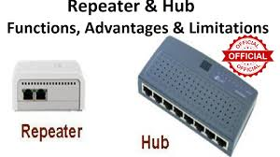
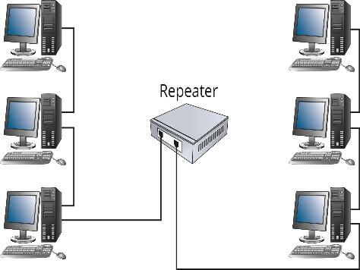
Network Repeaters and Hubs (2 of 2)
Figure 2-2 A repeater extends the distance a network can cover

Slide 5
Multiport Repeaters and Hubs (1 of 5)
A multiport repeater is just a repeater with several ports to which you can connect cabling
It is also referred to as a hub
A hub receives bit signals generated from a connected computer on one of its ports
It cleans the signal by filtering out electrical noise
Then regenerates the signal to full strength
Transmits the regenerated signal to all other ports a computer (or other network device) is connected to

Slide 6
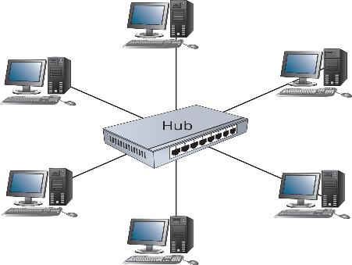
Multiport Repeaters and Hubs (2 of 5)
Figure 2-3 A multiport repeater or hub

Slide 7
Multiport Repeaters and Hubs (3 of 5)
The amount of data that can be transferred during a specified unit of time is network bandwidth
Bandwidth is usually measured in bits per second (bps)
Throughput measures how much data is being transferred over a given period of time
Propagation delay is the time between the moment a device receives data on one port and the moment it transmits data out another port
Latency is the cumulative delays among all devices between the source and destination

Slide 8
Multiport Repeaters and Hubs (4 of 5)
Buffering is another type of delay in which a device has to temporarily store outgoing or incoming packets while other packets are being processed by the OS
Goodput measures the amount of useful data that is transferred in a given time
Hubs share bandwidth with all other connected computers
Only one computer can successfully transmit data at a time
Bandwidth sharing occurs when all computers connected to the hub must share the amount of bandwidth the hub provides

Slide 9
Multiport Repeaters and Hubs (5 of 5)
Most hubs have indicator lights for the following:
A link status indicator light glows when a cable has been plugged in a port and a valid network connection has been made
When the hub receives bit signals on any of its ports, the network activity indicator flashes
A collision indicator port lights up whenever a collision is detected
When two stations try to transmit at the same time, a collision occurs
Those stations must retransmit their data
An uplink port is a port used to connect two hubs or switches together

Slide 10
Network Switches
A network switch looks just like a hub
However, a switch actually reads data in the message, determines which port the destination device is connected to, and forwards the message to only that port
Hubs work only with electrical signals and the bits these signals represent
Switches work with the actual information these bits represent
The unit of information that switches work with is called a frame

Slide 11
Basic Switch Operation (1 of 5)
Data is sent onto the medium one frame at a time
Each frame has the destination MAC address and the source computer’s MAC address
When the frame reaches a switch, the switch reads both addresses:
It keeps a record of which computer is on which port
It forwards the frame to the port where the destination MAC can be found
A switch maintains a switching table of MAC addresses that have been learned and their associated port numbers

Slide 12
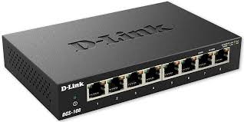
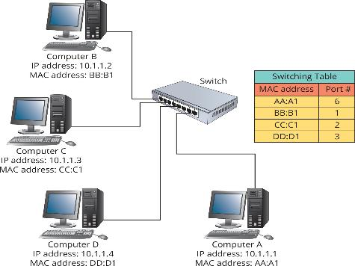

Basic Switch Operation (2 of 5)
Figure 2-5 Switches maintain a switching table, also referred to as a MAC address table

Slide 13
Basic Switch Operation (3 of 5)
A switches operation can be summarized in the following steps:
The switch receives a frame
The switch reads the source and destination MAC addresses
The switch looks up the destination MAC address in its switching table
The switch forwards the frame to the port where the computer owning the MAC address is found
The switching table is updated with the source MAC address and port information

Slide 14
Basic Switch Operation (4 of 5)
Switches can handle several computer conversations at one time
Therefore, each port gets full network bandwidth instead of having to share bandwidth with all ports (dedicated bandwidth)
Switches can operate in full-duplex mode, which means devices can send and receive data simultaneously
Hubs can only operate in half-duplex mode, which means a device can send or receive (but not both) at one time
Switches are the preferred device because of these advantages

Slide 15
Basic Switch Operation (5 of 5)
Like hubs, switches have indicator lights
Switches have link status indicators and activity indicators
They may also have indicators for whether the switch is operating in full-duplex or half-duplex mode
Switches can be connected to one another so that your LAN can grow beyond the limitations of ports on a single switch
Some switches have a dedicated port for uplinking to another switch

Slide 16
Knowledge Check Activity 2-1
What mode of operation allows a device to send and receive data simultaneously?
a. Half-duplex
b. Dedicated
c. Buffering
d. Full-duplex

Slide 17
Knowledge Check Activity 2-1: Answer
What mode of operation allows a device to send and receive data simultaneously?
Answer: d. Full-duplex
Explanation: A device that can send and receive data simultaneously is operating in full-duplex mode. In half-duplex mode, a device can send and receive data but not at the same time. Dedicated and buffering are not modes of operation.

Slide 18
Wireless Access Points (1 of 2)
The heart of a wireless network is the wireless access point (AP)
APs operate similarly to a hub without wires
All communication passes through the AP
Most small business and home networks use a device typically called a wireless router that combines the functions of an AP, a switch, and a router
Wireless networks are usually attached to wired networks
APs typically have one or more connectors for connecting to a wired Ethernet network

Slide 19


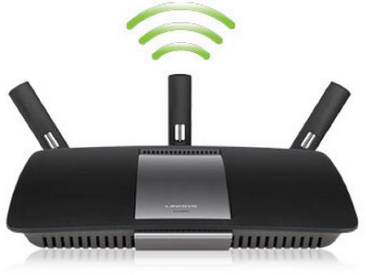
Wireless Access Points (2 of 2)
Figure 2-9 A wireless router combines an access point, a switch, and a router

Slide 20
Basic AP Operation (1 of 2)
With an AP, all stations hear all network data being transmitted
The following is an extra step that is required:
The receiving device sends an acknowledgement back to the sending device to indicate successful reception
Some configurations require additional handshaking:
The sending station must send a request to send (RTS) message and receive a clear to send (CTS) message before transmitting
The RTS/CTS ‘handshake’ lets all other stations know that another station is about to transmit

Slide 21
Basic AP Operation (2 of 2)
All the extra chatter required to send data in a wireless network slows communication
The effective bandwidth is about half the physical bandwidth
Most APs operate from 11Mbps to several Gbps
A common operating speed is 200 Mbps
A wireless AP operating at 200 Mbps shares this with all computers in the wireless network
If 10 stations are connected to a 200 Mbps wireless network, each station has 20 Mbps of effective bandwidth

Slide 22
NIC Basics (1 of 6)
Most NICs are built into a computer’s motherboard
They occasionally fail or additional NICs are needed for an application
It is important to know how to install a new NIC
Attaching a computer to a network requires a network interface card (NIC) to create and mediate the connection between a computer and the networking medium
Networking medium might be copper wire, fiber-optic cable, or airwaves
Data is represented as bit signals that the NIC transmits or receives

Slide 23
NIC Basics (2 of 6)
The tasks a NIC and its driver perform include the following:
Provide a connection from the computer to network medium
For incoming messages, receive bit signals and assemble them into frames, verify the destination address and the error-checking code, remove frame header and trailer, and send the resulting packet to the network protocol
For outgoing messages, receive packets from network protocol and create frames by adding MAC addresses and the error-checking code
Convert the frame into bit signals suitable for the medium and transmit them

Slide 24
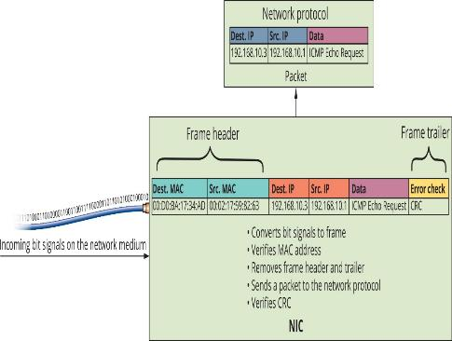
NIC Basics (3 of 6)
Figure 2-10 A NIC handles incoming data from the network medium

Slide 25
NIC Basics (4 of 6)
NIC manufacturers ensure that every NIC produced has a unique address
Networks won’t function correctly if duplicate MAC addresses exist
A MAC address is stored in nonvolatile memory on the NIC
The MAC address is composed of two 24-bit hexadecimal numbers:
24-bit manufacturer ID called an organizationally unique identifier (OUI)
24-bit serial number assigned by the manufacturer
The 48-bit address is expressed in 12 hexadecimal digits, such as 04-40-31-5B-1A-C4

Slide 26
NIC Basics (5 of 6)
When a frame arrives at a NIC, the NIC checks the frame’s destination MAC address to see whether it matches it’s built-in MAC address
The NIC only permits inbound communications if:
The destination MAC matches the NICs built-in address
The destination MAC is a broadcast address (FF-FF-FF-FF-FF-FF)
The NIC is in a special mode called promiscuous
A frame with a destination MAC address composed of all binary 1s or FF-FF-FF-FF-FF-FF in hexadecimal is a broadcast frame

Slide 27
NIC Basics (6 of 6)
Destination MAC addresses intended for a single computer are called unicast frames
Most NICs can operate in promiscuous mode
This mode turns off the gatekeeper functions and enables the NIC to process all frames it sees
NICs have indicator lights to show status information
Usually a link status indicator and an activity indicator
The link light is usually green when the NIC has a valid connection to the network medium

Slide 28
Selecting a NIC
NICs are often built into motherboard
However, an additional NIC or a faster NIC may need to be installed
When selecting a NIC you need to select correct bus interface
The connection the NIC makes to the motherboard is the bus connection
The NIC driver (software) must be available for your OS
For desktops, a standard NIC is good enough
For servers, consider a NIC that has onboard memory, multiple ports and connects at 10 Gbps and supports advanced features

Slide 29
NIC Drivers (1 of 2)
Most OSs ship with drivers for a wide range of NICs
Most NICs include drivers for the most common OSs
In most cases you only need to install the NIC and restart your computer
If the OS has a suitable driver available, it is installed automatically
After installation, the NIC is usually ready to function without further configuration
In Windows 11, you can verify that the NIC is installed in the Network & internet settings window

Slide 30
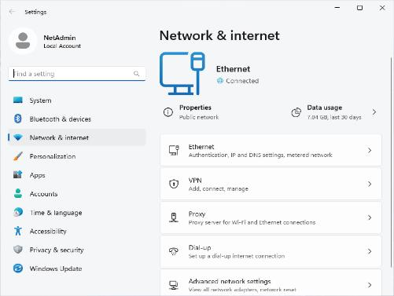
NIC Drivers (2 of 2)
Figure 2-12 The Network & internet settings in Windows 11

Slide 31
Wireless NICs
Wireless NICs must be chosen according to type of wireless AP being used
Typical are Wireless-n, 802.11ac or 802.11ax
The letters after 802.11 refer to the wireless networking standard the device supports
Wireless NICs connect to a network using service set identifier (SSID)
SSID is the name assigned to the wireless network
You may also need to enter a security key or a username and password, depending on the network’s security configuration

Slide 32
Routers (1 of 3)
Routers are the most complex devices in this chapter
Routers connect LANs together to create an internetwork
They typically have two or more network ports to which switches or hubs are connected
Routers are devices that enable multiple LANs to communicate with one another by forwarding packets from one LAN to another

Slide 33
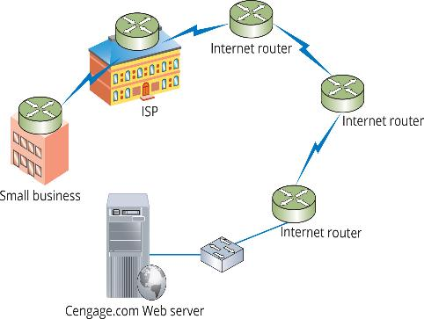
Routers (2 of 3)
Figure 2-16 Routers interconnect LANs to form the Internet

Slide 34
Routers (3 of 3)
The following are the differences between routers and switches:
Routers connect LANs, switches connect computers
Routers work with logical (IP) addresses, switches work with physical (MAC) addresses
Routers work with packets; switches work with frames
Routers don’t forward broadcasts, switches do
Routers use routing tables populated with IP addresses, switches use switching tables populated with MAC addresses

Slide 35
Routers Connect LANs (1 of 2)
As computers are added to a LAN, effective communication can suffer
Broadcast traffic is forwarded to all members of a LAN and can cause a network to become congested
The pictures on the next two slides shows 3 different user groups and 3 different servers
The first picture shows all devices connected by switches, so all broadcast traffic will be heard by all devices
The second picture shows three smaller LANs connected by a router, creating three different broadcast domains

Slide 36
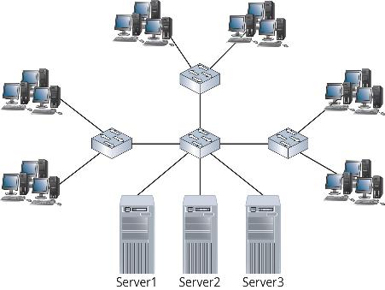
Routers Connect LANs (2 of 2)
Figure 2-17 A large LAN connected by switches

Slide 37
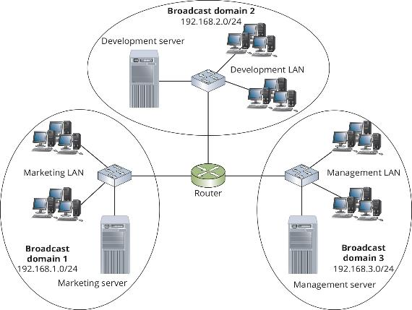
Routers Create Broadcast Domains
Figure 2-19 Each router creates a broadcast domain

Slide 38
Routers Work with IP Addresses and Routing Tables (1 of 4)
Routers maintain routing tables composed of IP network addresses and interface pairs to determine where to forward packets on an internetwork
When a router receives a packet on one interface, it looks at the destination IP address in the packet to determine to which network the packet is addressed
It then forwards the packet out of the interface that its routing table indicates is the best path to get to the destination
If the packet must be sent to another router on another network, that network is known as a remote network

Slide 39
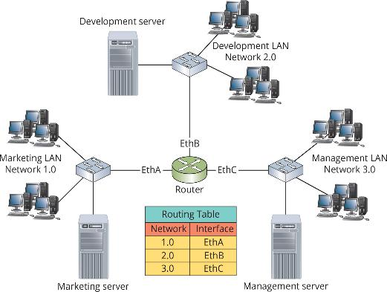
Routers Work with IP Addresses and Routing Tables (2 of 4)
Figure 2-20 An internetwork with a routing table

Slide 40
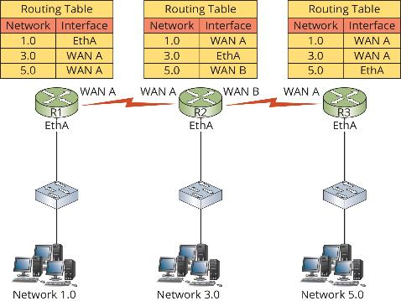
Routers Work with IP Addresses and Routing Tables (3 of 4)
Figure 2-21 Packets are forwarded through multiple routers

Slide 41
Routers Work with IP Addresses and Routing Tables (4 of 4)
A default route tells the router where to send a packet when the router doesn’t have an entry in its routing table
Network unreachable is a message a router might send to the sending station when the network can’t be found
Default gateway in a computer’s IP address configuration must be set to the address of a router to which the computer can send all packets destined for other networks

Slide 42
Knowledge Check Activity 2-2
Which of the following is true about routers?
a. They work with MAC addresses.
b. They maintain a switching table.
c. They don’t forward broadcasts.
d. They flood a packet with an unknown destination address.

Slide 43
Knowledge Check Activity 2-2: Answer
Which of the following is true about routers?
Answer: c. They don’t forward broadcasts.
Explanation: Routers work with IP addresses while switches work with MAC addresses. Routers maintain a routing table while switches maintain a switching table. Routers discard a packet with an unknown destination address or forward the packet to the default route. Routers do not forward broadcast packets, whereas switches do forward broadcasts.

Slide 44
Self Assessment
Name the differences between switches and routers.
You currently have 15 switches with an average of 20 stations connected to each switch. The switches are connected to one another so that all 300 computers can communicate with one another in a single LAN. You have been detecting a high percentage of broadcast frames on this LAN. You think the number of broadcasts might be having an impact on network performance. What should you do?

Slide 45
Summary
Now that the lesson has ended, you should be able to:
Describe the basic operation of network repeaters and hubs
Explain the operation of network switches
Explain how wireless access points work
Describe the operation of network interface cards
Explain the function of routers

